Slide 1
Failure Detection of Air-Craft Engines using Recurrent Neural Networks/LSTM.
Instructor: Dr. David he By: Akshay Singh
Ashish Govind shinde
shrinivas kallol

Slide 2
FLOW
INTRODUCTION
OBJECTIVE
LITERATURE SURVEY
DATA PRE-PROCESSING
STATISTICAL MODELLING
LIMITATIONS
SOLUTION
CONCLUSION

Slide 3
INTRODUCTION
A major problem faced by businesses in asset-heavy industries such as manufacturing is the significant costs that are associated with delays in the production process due to breakdown of machineries or equipments.

Slide 4

OBJECTIVE
Develop a failure detection model using Recurrent Neural Networks/Long Short-Term Memory which would predict if the air-craft engine is going to fail in future or not.
This model will help the companies to take pre-cautionary actions of maintenance on the engines so that breakdown can be avoided which in turn will save a lot of time and money for them.

Slide 5
LITERATURE REVIEW
PAPER TITLES | AUTHORS | PUBLISHED Date
Remaining Useful Life Prediction of Hybrid Ceramic Bearings Using an Integrated Deep Learning and Particle Filter Approach | Jason Deutsch, Miao He and David He | 23 June 2017
Aircraft engine health prognostics based on logistic regression with penalization regularization and state-space-based degradation framework | Jianbo Yu | 23 May 2017
Fault Tolerant Control, Artificial Intelligence and Predictive Analytics for Aerospace Systems: An Overview | Krishna Dev Kumar, Venkatesh Muthusamy | 11 October 2017
Fault Diagnosis from Raw Sensor Data Using Deep Neural Networks Considering Temporal Coherence | Ran Zhang, Yong Guan Zhen Peng, Lifeng Wu, Beibei Yao | 9 March 2017
Fault diagnosis of low speed bearing based on relevance vector machine and support vector machine | Achmad Widodo, Eric Y.Kim, Jong-DukSon ,Bo-SukYang, Andy C.C. Tan, Dong-Sik Gu, Byeong-Keun Choi, Joseph Mathew | April 2009
A Review of Machine Learning based Anomaly Detection Techniques. | Harjinder Kaur, Gurpreet Singh, Jaspreet Minhas | 10 March 2013
Deep Learning for Time-Series Analysis | John Gamboa | 7 January 2017
Optimizing Recurrent Neural Networks Architectures under Time Constraints | Junqi Jin, Ziang Yan, Kun Fu, Nan Jiang, Changshui Zhang | 19 March 2017

Slide 6
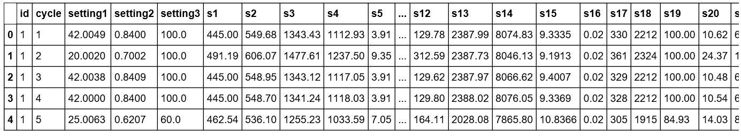
DATASET DESCRIPTION
Dataset was taken from https://ti.arc.nasa.gov/tech/dash/pcoe/prognostic-data-repository/#turbofan.
Dataset had 61249 rows and 28 columns, target variable was not given in the dataset.
The columns represent the readings taken by different sensors, id of the engine and the cycle corresponding to the sensor readings.

Slide 7
DATA PRE-PROCESSING
Reading the data, which was a text file into a pandas Data frame
Checking for missing values
Reformatting the data frame by sorting the id, cycle columns
Generating Remaining Useful Life for each cycle
Generating label (Last 30 cycles of an engine were labeled as 1 which indicated failure)
Number of Failing instances were 7719 and Not-Failing instances were 53530.
Normalizing the data using “Min_Max_Scalar” function
Principal Component Analysis was implemented, retaining 90% of the variance.
Number of Principal Components explaining 90% of variance was obtained to be 2.
The train-test split was taken to be 80:20.

Slide 8
ONE STEP EXTRA FOR RNN/LSTM
LSTM layers expect an input in the shape of a numpy array of 3 dimensions (samples, time steps, features) where samples is the number of training sequences, time steps is the look back window or sequence length and features is the number of features of each sequence at each time step.
A Function was created to reshape features into samples, time steps, features.
Only sequences that meet the window-length are considered, no padding is used.
Feature columns was picked and the sequence was generated and converted to numpy array.
Finally, a function to generate labels was also created.

Slide 9

DATASET IS READY FOR MODELLING!

Slide 10

MODELLING
Random Forest
Support Vector Machines
Recurrent Neural Networks/LSTM ( Long-Short Term Memory)

Slide 11
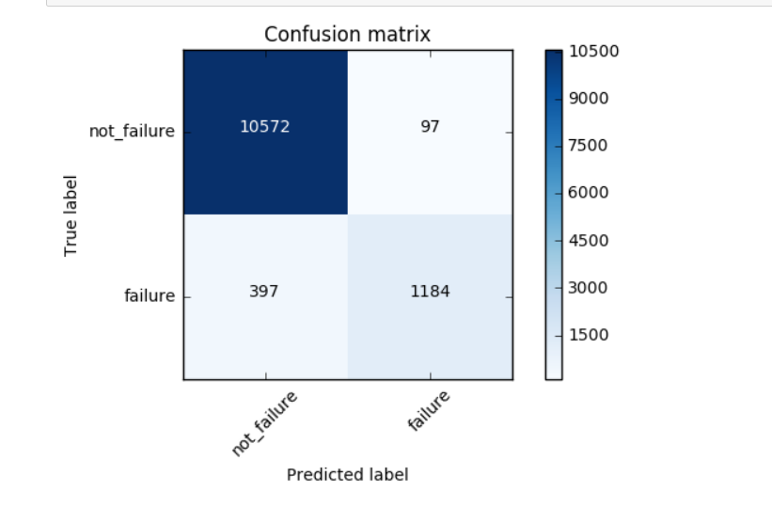
RANDOM FOREST
Criterion=‘gini’ ; Number of estimators=10 ; Bootstrap=‘True’.
Accuracy= 95.9%
Precision= 92.4%
Recall= 74.8%

Slide 12
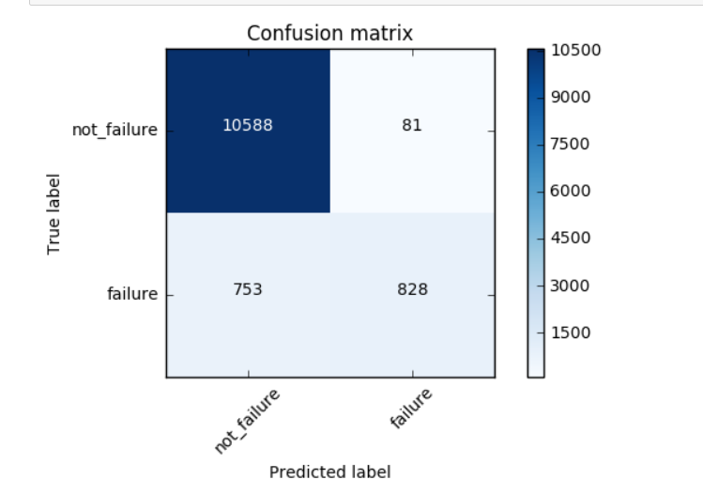
Support Vector Machines
C=10 ; kernel=‘rbf’
Accuracy=93.1%
Precision= 91%
Recall= 52.3%

Slide 13
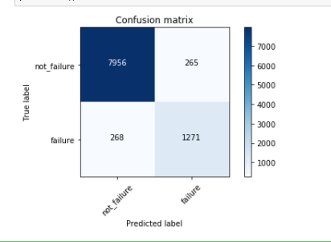
RECURRENT NEURAL NETWORK/LSTM
An architecture with 2 stacked LSTM layers and 1 Dense Layers was used.
Batch Size=200
Epochs= 10
Sequence= 50
Dropout was taken to be 0.2.
Activation Function= ‘Sigmoid’
Optimizer= ‘SGD’
Accuracy= 94.5%
Precision=82%
Recall= 82.5%

Slide 14
COMPARISION
 | Accuracy(%) | Precision(%) | Recall(%)
Random Forest | 95.9 | 92.4 | 74.8
Support Vector Machines | 93.1 | 91 | 52
RNN/LSTM | 94.5 | 82.0 | 82.5

Slide 15
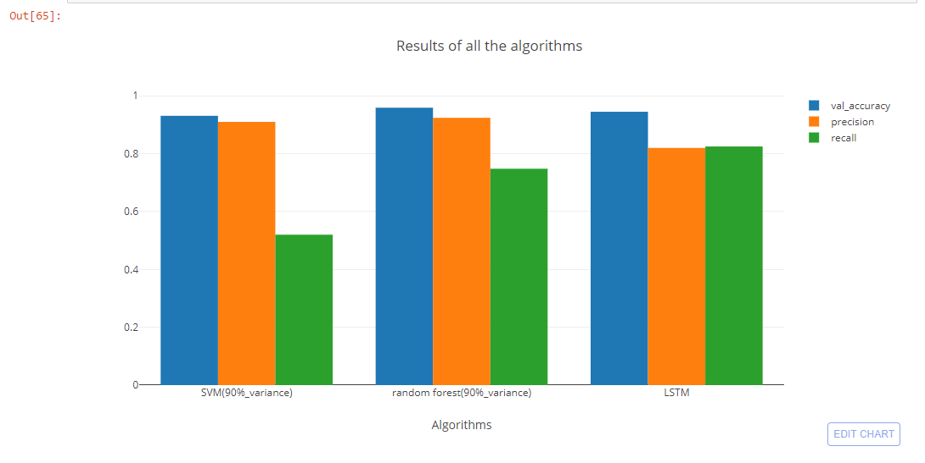
VISUAL COMPARISION

Slide 16



Slide 17


Slide 18
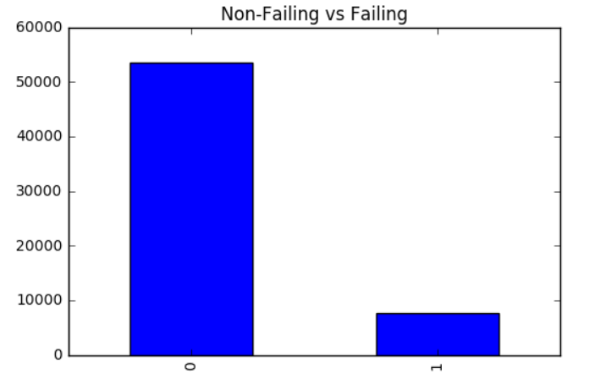
Imbalance in Class-Distrubution

Slide 19
Let’s check Confusion Matrix Again!
Algorithm | Recall
Random Forest | 74.8%
Support Vector Machines | 52%
RNN/LSTM | 82.5%
Random forest
SVM
LSTM

Slide 20
SOLUTION!
In such instances where the class in highly imbalanced we should perform sampling.
Various techniques available for sampling are Under-sampling the majority class, Oversampling the minority class or Under-sampling followed by oversampling at the same time.
Our adopted technique was “Oversampling of Minority Class” using SMOTE(Synthetic Minority Over-sampling Technique).

Slide 21
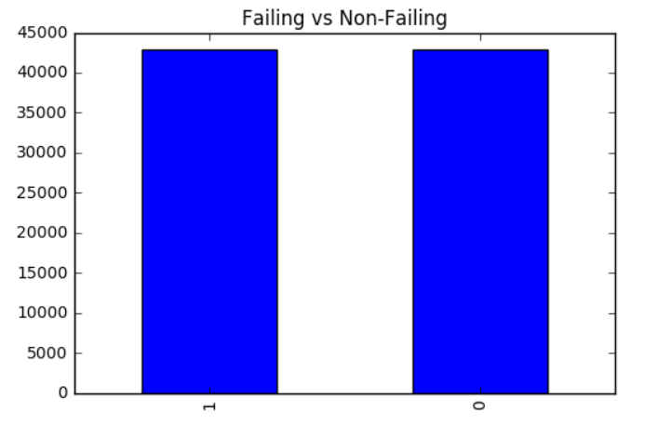
VISUALIZING CLASS DISTRIBUTION AFTER SMOTE
Both the classes look perfectly balanced.

Slide 22
MODELLING ON OVERSAMPLED DATA
Under the same parameters, now the result table looks like this:
 | Accuracy(%) | Precision(%) | Recall(%)
Random Forest | 94.9 | 79 | 81
Support Vector Machines | 95 | 76 | 90
RNN/LSTM | 97.32 | 98 | 97.4

Slide 23
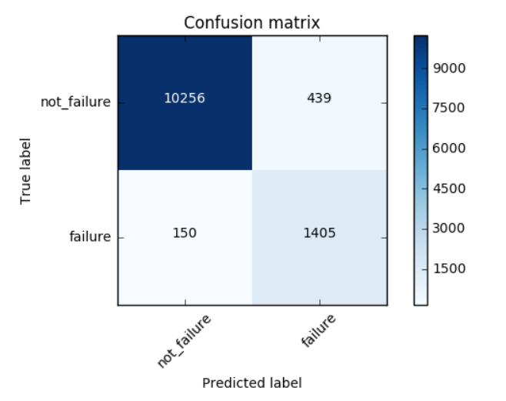
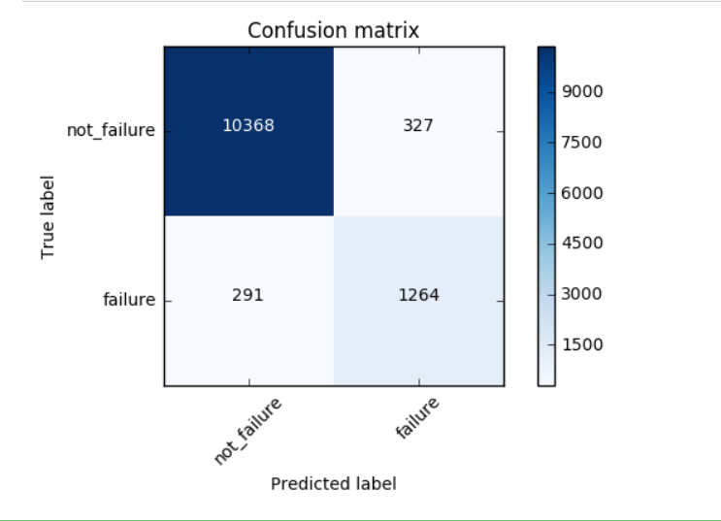
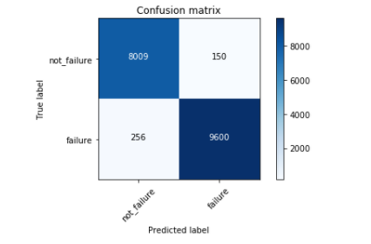
Confusion matrix of all algorithms
SVM
Random forest
LSTM

Slide 24
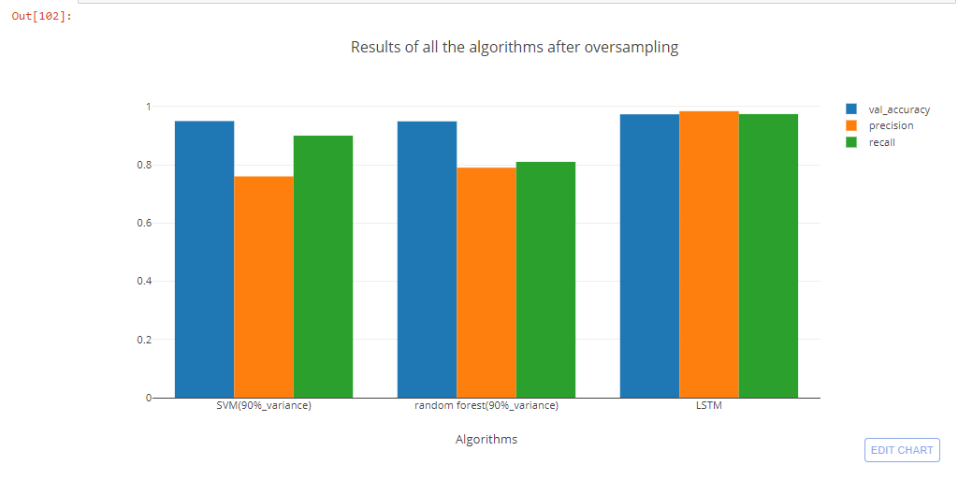
VISUAL COMPARISION

Slide 25
INFERENCES
RNN/LSTM works way better than Random Forest and Support Vector Machines because of it’s ability to perform well on large datasets. Therefore, in this project we can conclude that as we increase the amount of data the tradeoff between RNN/LSTM and other machine learning algorithms will be higher.
There is a very slight change in the Recall for Random Forest because of the fact that it works on the concept of ‘Bootstrap’ and that oversampling brings no change to it.

Slide 26
PARAMETERS TUNING IN LSTM
There are two approaches for tuning the parameters in LSTM:
Algorithmic Approach
Manual Approach
Although algorithmic approach requires less labor and gives more accurate results but it is very much dependent on the specifications of your machine.
We used Manual Approach for tuning the parameters such as Batch Size and Sequence Length.

Slide 27
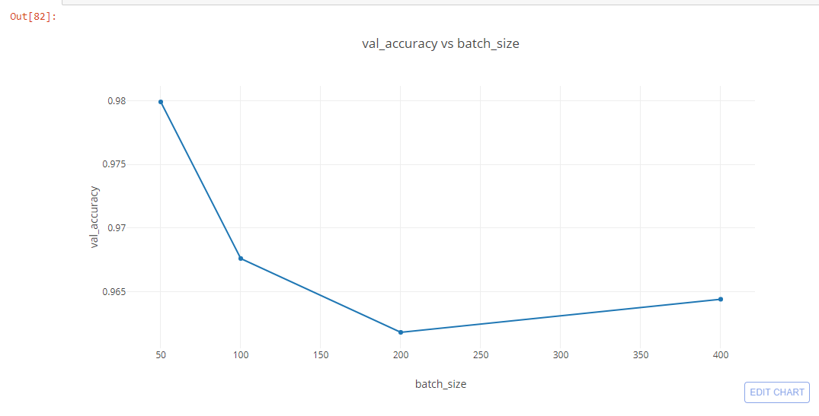
TUNING OF BATCH SIZE
We tried to understand the change in accuracy with changing batch size.
Batch Size= 50,100,200,400
The best accuracy is obtained when Batch Size is 50.

Slide 28
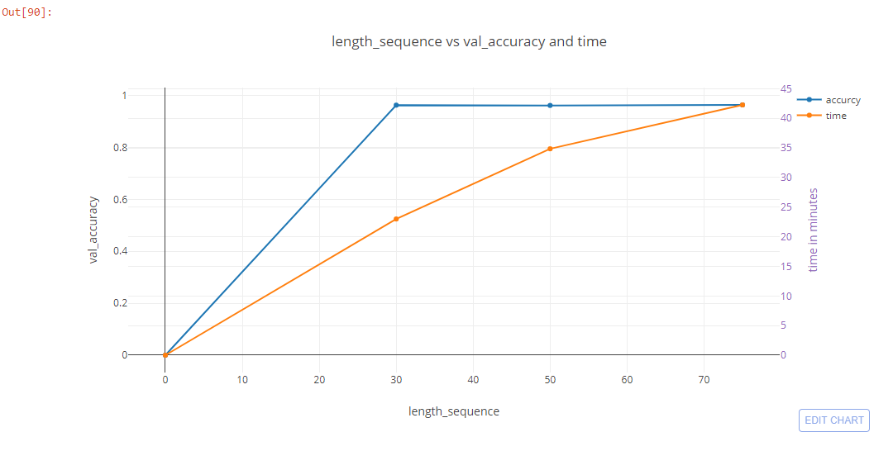
TUNING OF SEQUENCE LENGTH
We tried to understand the change in accuracy and time with changing Sequence Length.
Sequence Length= 30,50,70
The best accuracy and the longest time is observed when Sequence Length is 30.

Slide 29
LSTM WITH VARIABLE LEARNING RATE
Two different approaches were used:
Time-Based Learning Rate Schedule
Drop-Based Learning Rate Schedule
Time-Based Learning Rate = LearningRate * 1/(1 + decay * epoch)
Drop-Based Learning Rate= InitialLearningRate * DropRate^floor(Epoch / EpochDrop)

Slide 30
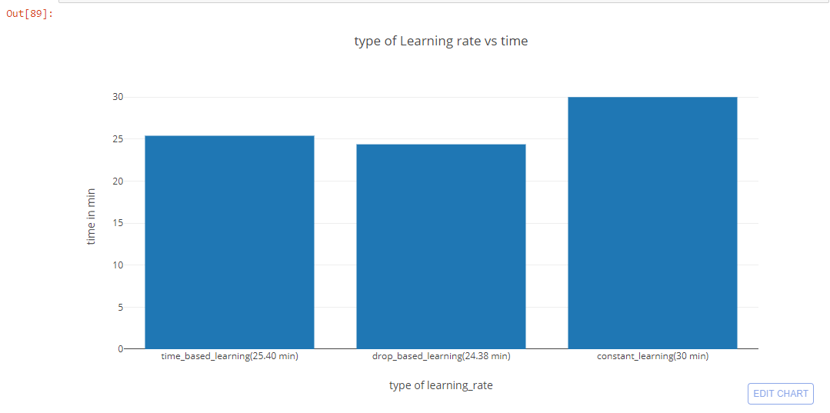
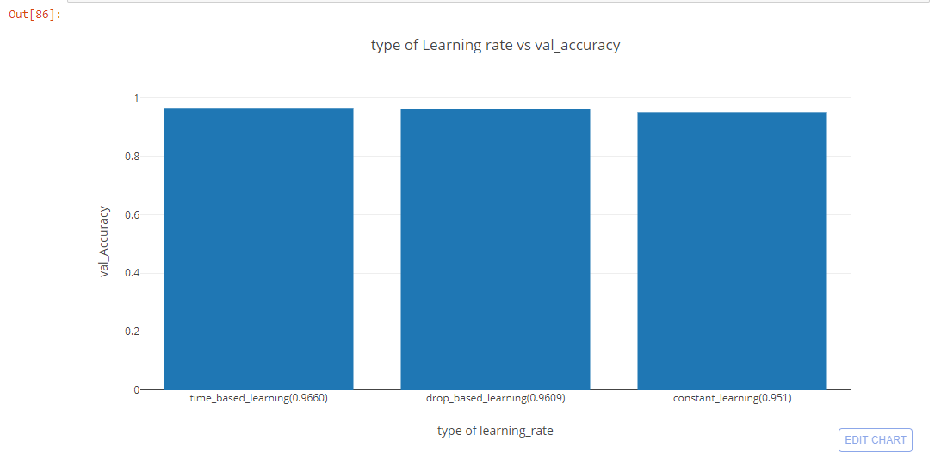
LSTM WITH VARIABLE LEARNING RATE
Type of learning rate vs time in min was plotted where for drop based learning it took less time
Type of learning rate vs accuracy was plotted where time based learning performed better

Slide 31
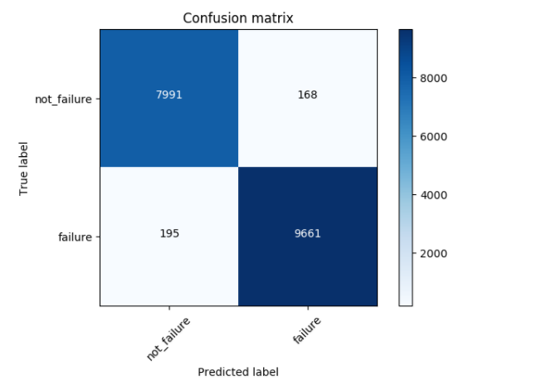
Final model-LSTM
An architecture with 2 stacked LSTM layers and 1 Dense Layers was used with optimized parameters.
Batch Size=50
Epochs= 10
Sequence= 30
Dropout was taken to be 0.2.
Activation Function= ‘Sigmoid’
Optimizer= ‘SGD’
Type of learning rate-time_based
Accuracy= 97.99%(earlier 97.32%)
Precision=98.2% (earlier 98.4%)
Recall= 98.02% (earlier 97.4%)

Slide 32
CONCLUSIONS
False-Negatives play an important role in Failure Detection and it needs to be minimized.
Sampling technique is one of the methods to create a balance between the classes and thereby improve the recall.
Sampling does not improve the results of Random Forest due to it’s inbuilt concept of Bootstrap.
The performance of RNN/LSTM improves as we feed in more data to it.
Using variable learning rate we can improve the computational time without compromising much on the accuracy.
Optimizing the parameters of RNN/LSTM can help us achieve higher accuracy without having to stack a large number of layers.

Slide 33
REFERENCES
https://machinelearningmastery.com/using-learning-rate-schedules-deep-learning-models-python-keras/
home.ustc.edu.cn/~zcgong/Paper/CIKM2016.pdf/
https://machinelearningmastery.com/adam-optimization-algorithm-for-deep-learning/
https://elitedatascience.com/keras-tutorial-deep-learning-in-python
https://keras.io/layers/recurrent/
https://keras.io/layers/recurrent/#simplernn
https://keras.io/layers/recurrent/#stackedrnncells

Slide 34

THANK YOU! QUESTIONS?

